Slide 1
Chapter 1: Introduction

Slide 2
Outline
The Need for Databases
Data Models
Relational Databases
Database Design
Introduction to SQL and MySQL

Slide 3
Database Management System (DBMS)
A database management system (DBMS) is system software for creating and managing databases.
The DBMS provides users and programmers with a systematic way to create, retrieve, update and manage data that is both convenient and efficient
A Few Examples of DBMS: Microsoft SQL Server, Oracle, MySQL, Postgres
Examples of Database-System Applications
Banking: For customer information, accounts, loans and transactions
Airlines: For reservations and schedule information
Universities: For student information, course registration and grades
Sales: For customer, product and purchase information
Notes:
3

Slide 4
Levels of Abstraction
Database systems are made-up of complex data structures.
To ease the user interaction with database, the developers hide internal irrelevant details from users.
This process of hiding irrelevant details from user is called data abstraction.
Notes:
4

Slide 5
Levels of Abstraction
Levels of abstraction
Physical level: describes how the data are actually stored, describes complex low-level data structures
Logical level: describes what data are stored in database, and what relationships exist among those data. Although implementation of the simple structures at the logical level may involve complex physical-level structures, the user of the logical level does not need to be aware of this complexity. This is referred to as physical data independence.
View level: At view level, user just interact with system with the help of a UI, they are not aware of how the data is stored and what data is stored; such details are hidden from them.
Notes:
5

Slide 6
Data Models
A data model provides a way to describe the design of a database at the physical, logical and view levels.
A data model is a collection of tools for describing data, data relationships, data semantics and data constraints.
There are different kinds of data model.
Relational model – uses a collection of tables to represent both data and relationships among those data
Object-based data models – combines features of relational data model and object-oriented features. Examples of object database include InterSystems Caché and Versant Object Database
Semi-structured data model - permits specification of data where data items of same type may have different sets of attributes. Standards to express semi-structured data include XML and Object Exchange Model.
Other older models:
Network model
Hierarchical model
Notes:
6

Slide 7
Instances and Schemas
Databases change over time as information is modified in them. The collection of information stored in a database at a particular moment is called an instance of the database.
The overall design of the database is called a schema.
Analogy to programming languages – A database schema corresponds to variable declaration along with the associated type. A database instance refers to the value of the variable at a given point in time.
There are different levels of schema based on the different levels of abstraction.
Physical schema describes the database design at the physical level
Logical schema describes the database design at the logical level
View-level schema describes the different views of the database
Physical Data Independence –physical and logical schema are independent of each other; one can be changed without affecting the other
Notes:
7

Slide 8
Data Storage and Querying
A database system is partitioned into modules that deal with each of the responsibilities of the overall system.
The functional components of a database system can be broadly divided into the storage manager and the query processor components.
Notes:
8

Slide 9
Storage Manager
The storage manager is responsible for storing, retrieving, and updating data in the database. It translates the various DML statements into low-level file-system commands. As such, it provides an interface between the low-level data stored in the database and the application programs and queries submitted to the system.
The storage manager components include:
Authorization and integrity manager, which tests for the satisfaction of integrity constraints and checks the authority of users to access data.
Transaction manager, which ensures that the database remains in a consistent (correct) state despite system failures, and that concurrent transaction executions proceed without conflicting.
File manager, which manages the allocation of space on disk storage and the data structures used to represent information stored on disk.
Buffer manager, which is responsible for fetching data from disk storage into main memory and deciding what data to cache in main memory. The buffer manager is a critical part of the database system, since it enables the database to handle data sizes that are much larger than the size of main memory.
Notes:
9

Slide 10
Query Processor
The query processor components include:
DDL interpreter, which interprets DDL statements and records the definitions in the data dictionary.
DML compiler, which translates DML statements into an evaluation plan consisting of low-level instructions that the query evaluation engine understands. A query can usually be translated into any of a number of alternative evaluation plans that all give the same result. The DML compiler also performs query optimization; that is, it picks the lowest cost evaluation plan from among the alternatives.
Query evaluation engine, which executes low-level instructions generated by the DML compiler.
Notes:
10

Slide 11
Transaction Management
A transaction is a collection of operations that performs a single logical function in a database application.
An example is a funds transfer in which one department account (say CS) is debited and another department account (say BIO) is credited.
In order to maintain consistency in a database, before and after transaction, certain properties are followed. These are called ACID properties.
Atomicity requires that either the entire transaction takes place at once or doesn’t happen at all. In the above example, it is essential that either both the credit and debit occur, or that neither occur. That is, the funds transfer must happen in its entirety or not at all.
Consistency refers to the correctness of the database requiring that the database is consistent before and after the transaction. In our example, the value of the sum of the balances of CS and BIO must be preserved.
Another requirement, isolation, ensures that multiple transactions can occur concurrently without leading to inconsistency of database state.
Finally, durability requires that once the transaction has completed execution, the updates and modifications to the database are stored in and written to disk and they persist even if a system failure occurs.
Notes:
11

Slide 12
Transaction Management
The transaction manager consists of the concurrency-control manager and the recovery manager.
The responsibility of concurrency-control manager is to control the interaction among the concurrent transactions, to ensure the consistency of the database.
The responsibility of recovery manager is to detect system failures and restore the database to the state that existed prior to the occurrence of the failure thereby ensuring atomicity and durability.
Notes:
12

Slide 13
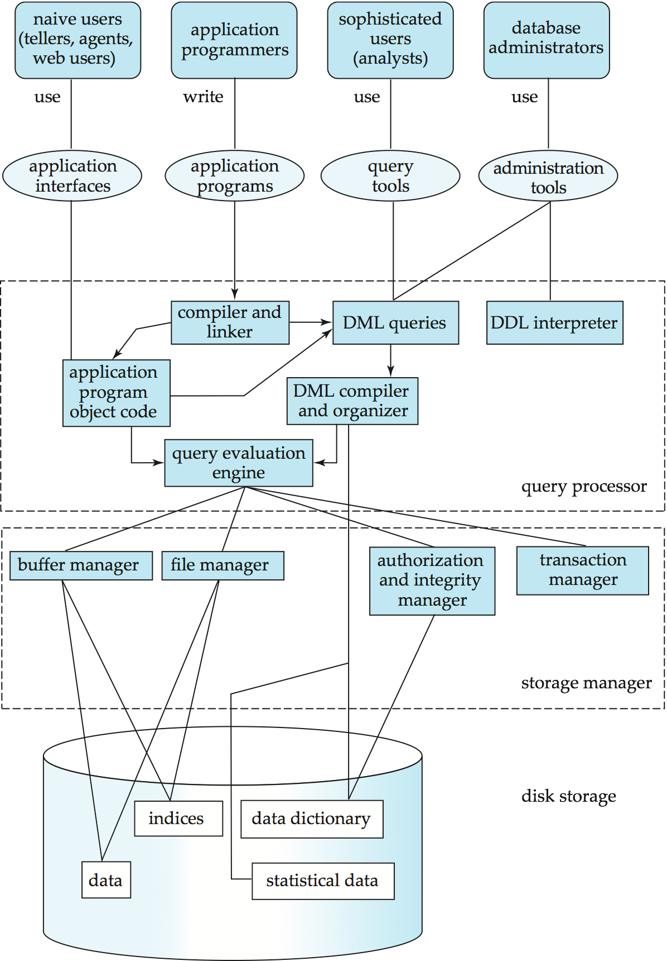
Database System Internals
Notes:
13

Slide 14
Database Architecture
The architecture of a database systems is greatly influenced by the underlying computer system on which the database is running:
Centralized
Distributed
Notes:
14

Slide 15
Database Languages
A database system provides
A data-definition language to specify the database schema (e.g., create, alter, drop)
A data-manipulation language to express database queries and updates (e.g., insert, update, delete)
In practice, the data-definition and data-manipulation languages are not two separate languages; instead they simply form parts of a single database language, such as the widely used SQL language.
Notes:
15

Slide 16
Data Definition Language (DDL)
Used for defining the database schema
Example: create table instructor ( ID char(5), name varchar(20), dept_name varchar(20), salary numeric(8,2));
The output of DDL compiler is stored in a data dictionary which contains metadata (i.e., data about data). The data dictionary is considered to be a special type of table that can only be accessed and updated by the database system itself (not a regular user). The database system consults the data dictionary before reading or modifying actual data.
DDL can also be used to specify various kinds of constraints on the data values:
Domain constraint – specifies what kind of values an attribute can take
Referential integrity constraint – values that appear in two different relations are consistent. For instance, the dept_name value in INSTRUCTOR table must also appear in the dept_name attribute in the DEPARTMENT table
Assertion – a condition that the database must satisfy. For instance, Every department must offer at least five courses every semester.
Authorization – providing different kinds of access to different kinds of users
Notes:
16

Slide 17
Data Manipulation Language (DML)
Language for accessing and manipulating the data which includes:
Insertion of information
Deletion of information
Modification of information
Retrieval of information also know as querying
Notes:
17

Slide 18
Classes of Languages
Two classes of languages
Pure – Provide theoretical foundation for commercial database query languages, used for proving properties about computational power and for optimization
Relational Algebra
Tuple relational calculus
Domain relational calculus
Commercial – used in commercial systems
SQL is the most widely used commercial language
Other examples – XQuery, SPARQL, YQL, etc.
Notes:
18

Slide 19
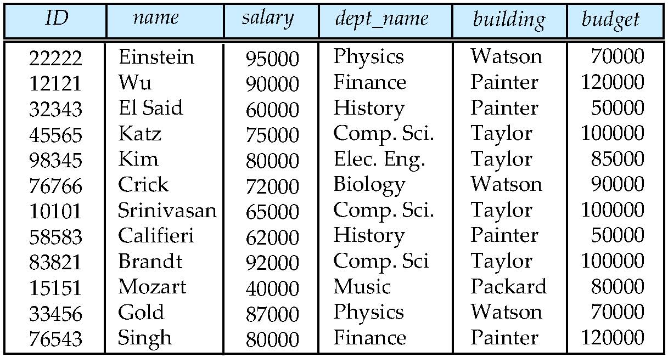
Database Design
Let’s say that you come up with the following table to store instructor data.
Could there be any problem with the design of this table?
Notes:
19

Slide 20
Design Approaches
Need to come up with a methodology to ensure that each of the relations in the database is “good”.
Two ways of doing so:
Entity Relationship Model
Models an enterprise as a collection of entities and relationships
Represented diagrammatically by an entity-relationship diagram:
Normalization Theory
Formalize what designs are bad, and test for them
Notes:
20

Slide 21
Requirements Gathering
But it all begins with Requirements Gathering!
Let’s say that we need to design a database for a University.
What data do we need to store?
Notes:
21

Slide 22
Requirements for a University Database
Let’s say that we need to design a database for the university based on the following characteristics. The initial specification of user requirements may be based on interviews with the database users, and on the designer’s own analysis of the organization.
The university is organized into departments. Each department is identified by a unique name (dept_name), is located in a particular building, and has a budget.
Each department has a list of courses it offers. Each course has associated with it a course_id, title, dept_name, and credits, and may also have associated prerequisites.
Instructors are identified by their unique ID. Each instructor has name, associated department (dept_name), and salary.
Students are identified by their unique ID. Each student has a name, an associated major department (dept_name), and tot_cred (total credit hours the student earned thus far).
Notes:
22

Slide 23
Requirements for a University Database
The university maintains a list of classrooms, specifying the name of the building, room number, and room capacity.
The university maintains a list of all classes (sections) taught. Each section is identified by a course id, sec id, year, and semester, and has associated with it a semester, year, building, room number, and time slot id (the time slot when the class meets).
The department has a list of teaching assignments specifying, for each instructor, the sections the instructor is teaching.
The university has a list of all student course registrations, specifying, for each student, the courses and the associated sections that the student has taken (registered for).
A real university database would be much more complex than the preceding design. However, we use this simplified model to understand conceptual ideas without getting lost in details of a complex design.
Notes:
23

Slide 24
File-Processing Systems
Before DBMSs were introduced, organizations such as a university usually stored information in operating system files
To allow users to manipulate the information, application programs were provided
Application program examples for University database
Add new students, instructors, and courses
Register students for courses, and generate class rosters
Assign grades to students, compute grade point averages (GPA) and generate transcripts
New application programs and files were added as needed. For instance, if the university created a new department, new files were added to the system to store information about this new department such as students in that major and course offerings by the department. New application programs were written to handle the rules of the department.
However, file-processing systems have a number of drawbacks.
Notes:
24

Slide 25
Drawbacks of using file systems to store data
Data redundancy and inconsistency
The same information may be duplicated. For instance, if a student has a double major, their personal information will appear in the files of both departments. This redundancy of information leads to higher cost of storage and may also lead to inconsistency if a changed address is reflected in the records of one department but not in the other one
Since different programmers create different files and programs, they will differ in their structure such as different file formats and may be written using different programming languages
Difficulty in accessing data
Need to write a new program to carry out each new task
For instance, if there is a need to find the names of all students who live in a particular zip-code, a new program needs to be written. Now, if there is a need to find the names of only those students with 60 credits, yet another program needs to be written
So, retrieving data is neither convenient nor efficient
Notes:
25

Slide 26
Drawbacks of using file systems to store data (Cont.)
Data isolation
Data is scattered in different files and possibly in different formats
So, writing programs to retrieve the required information is tedious
Integrity problems
Data stored in database must satisfy certain conditions called integrity constraints. For instance, the budget of a department cannot fall below 0
These constraints can be enforced by writing appropriate code in the program
However, over time it becomes difficult to add new constraints or change existing ones, especially when the constraints involve data from multiple files
Security problems
Not every user should be able to access all the data. For instance, students should not be able to view each others GPA
Hard to provide user access to some, but not all, data using file processing systems
Notes:
26

Slide 27
Drawbacks of using file systems to store data (Cont.)
Atomicity problems
Suppose that Dept. A needs to transfer $500 to Dept. B. If there is a system failure during the execution of the program, it is possible that $500 was removed from the balance of Dept. A but wasn’t credited to the balance of Dept. B resulting in an inconsistent database state
In this case, funds transfer need to be atomic, i.e., it must happen in its entirety or not at all
It is difficult to ensure atomicity in file-processing systems
Concurrent access anomalies
Uncontrolled concurrent accesses can lead to inconsistencies
Example: Two people reading a balance (say $1000) and updating it by withdrawing money (say $100 each) at the same time
Some form of supervision of concurrent access is required, which is difficult with file-processing systems
Database systems offer solutions to all the above problems
Notes:
27

Slide 28

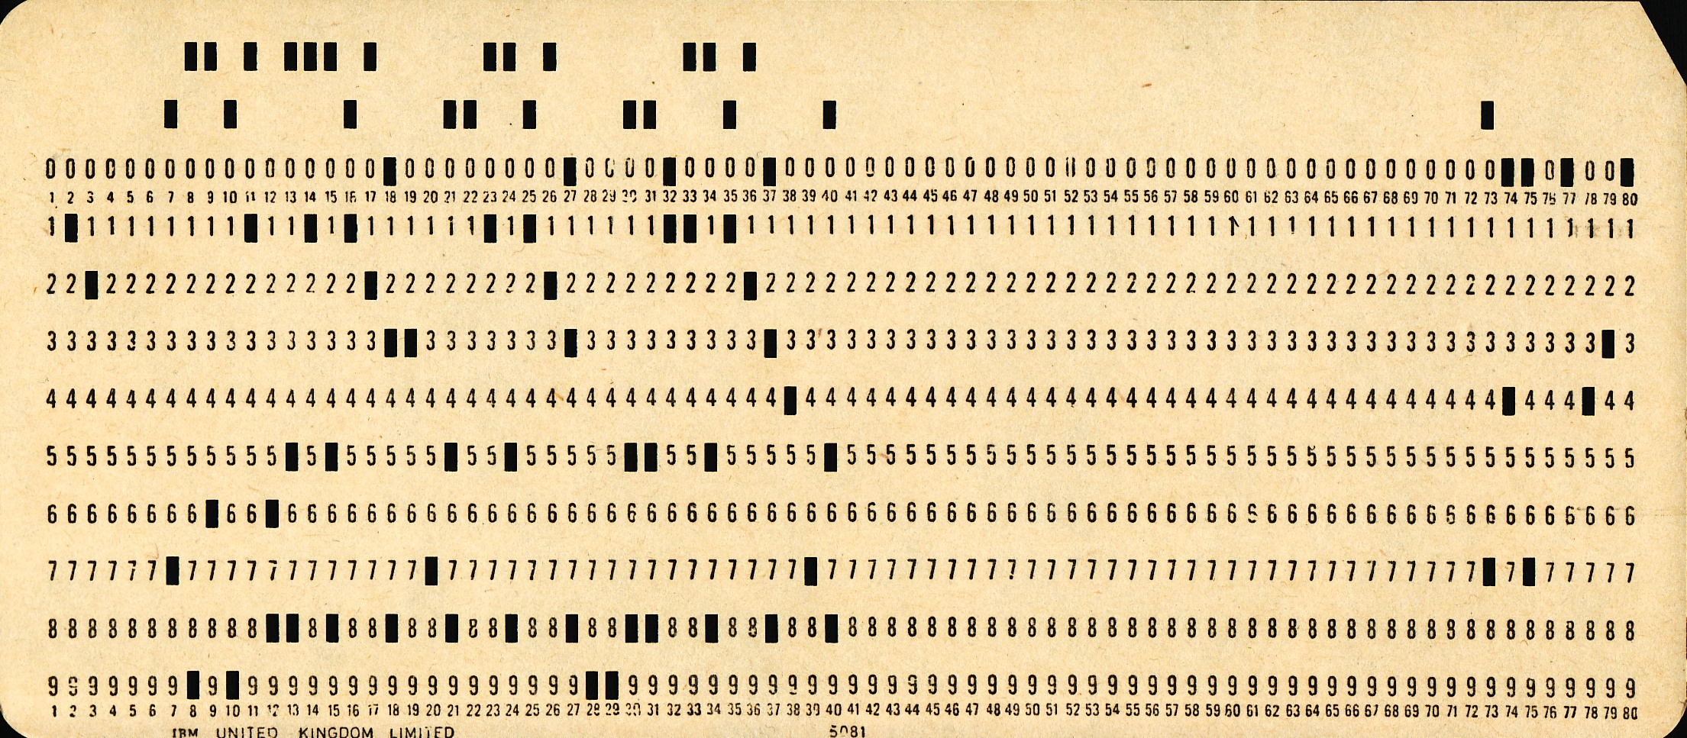
History of Database Systems
1950s and early 1960s:
Data processing using magnetic tapes for storage
Tapes provided only sequential access
Punched cards for input
Notes:
28

Slide 29
History of Database Systems
Late 1960s and 1970s:
Hard disks allowed direct access to data
Network and hierarchical data models in widespread use
Ted Codd defines the relational data model
Would win the ACM Turing Award for this work
IBM Research begins System R prototype
UC Berkeley begins Ingres prototype
Notes:
29

Slide 30
History (cont.)
1980s:
Research relational prototypes evolve into commercial systems
SQL becomes industrial standard
Parallel and distributed database systems
Object-oriented database systems
1990s:
Emergence of Web commerce
Reliability and Availability became important
Databases were deployed much more extensively than ever before
2000 and beyond:
New standards emerged - XML and XQuery standards, NoSQL
Open-source database systems, notably PostgreSQL and MySQL saw increased use
Data-mining gained prominence and database systems have evolved to serve this need
Notes:
30

Slide 31
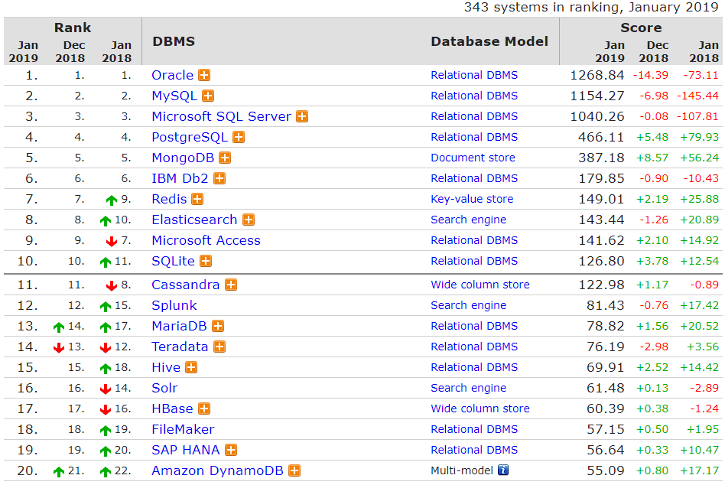
Most Popular Databases
Based on 2019 January DB-Engines Ranking
https://db-engines.com/en/ranking
Notes:
31

Slide 32
End of Chapter 1
Notes:
32

